Slide 1

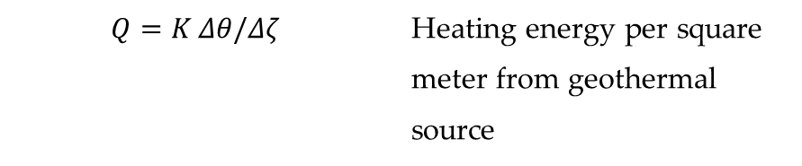
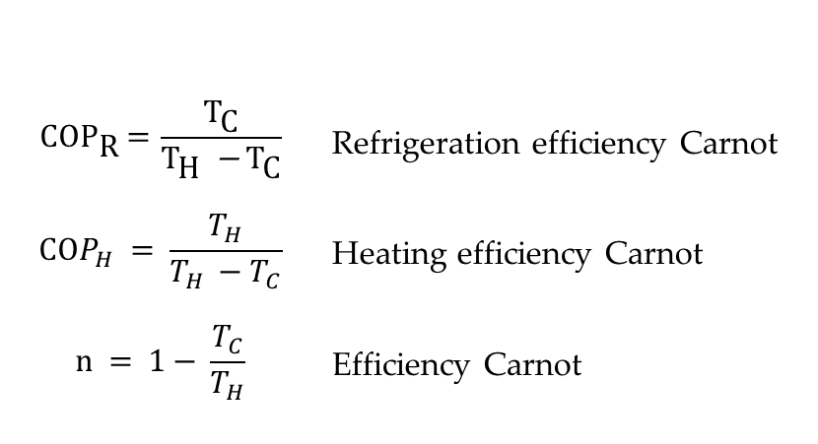
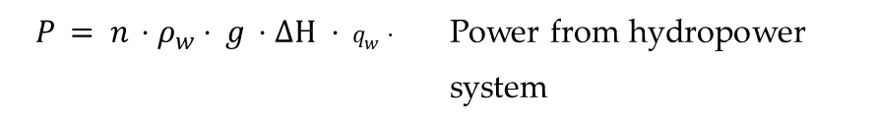
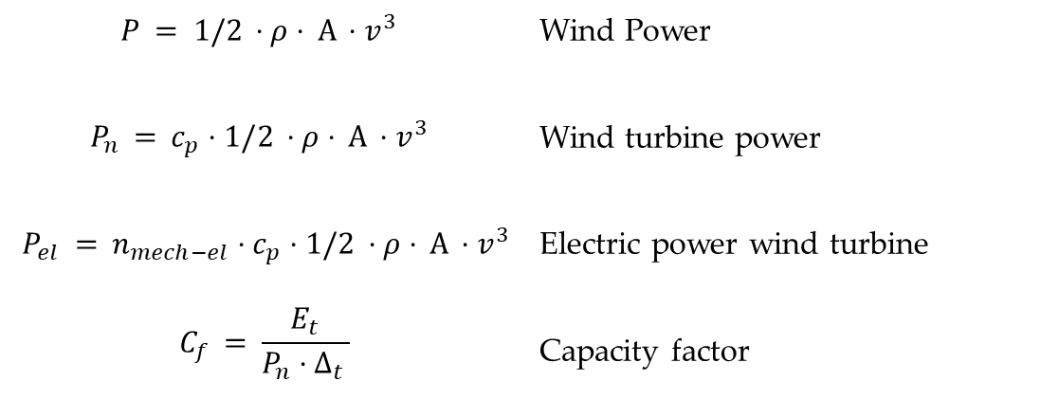
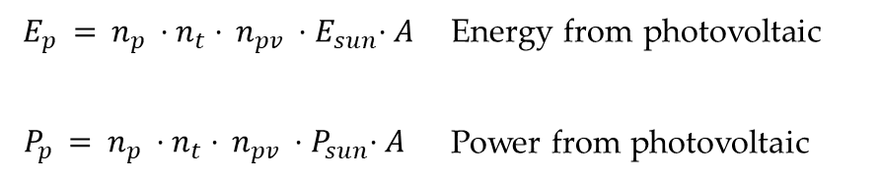
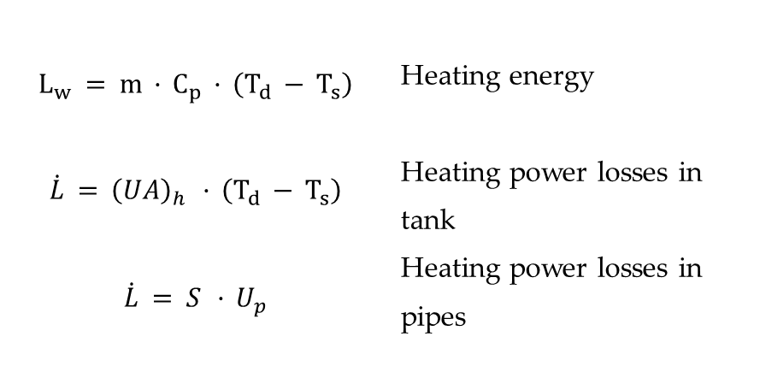
$$Ε_{p} = n_{p} ⋅n_{t}⋅ n_{pv} {⋅E}_{sun}⋅A$$ $$P_{p} = n_{p} ⋅n_{t}⋅ n_{pv} {⋅P}_{sun}⋅A$$ | Energy from photovoltaic Power from photovoltaic
Μπαραδάκης Ε.
$$\text{CO}{\text{P}}_{\text{R}}\text{ = }\frac{{\text{T}}_{\text{C}}}{{\text{T}}_{\text{H}} {\text{−} \text{T}}_{\text{C}}}$$ $$COP_{H} = \frac{T_{H}}{T_{H} {− T}_{C}}$$ $$n = 1− \frac{T_{C}}{T_{H}}$$ | Refrigeration efficiency Carnot Heating efficiency Carnot Efficiency Carnot
$$P = 1/2 ⋅ρ⋅ Α ⋅v^{3}$$ $$P_{n} = c_{p}⋅1/2 ⋅ρ⋅ Α ⋅v^{3}$$ $$P_{el} = {n_{mech−el}⋅c}_{p}⋅1/2 ⋅ρ⋅ Α ⋅v^{3}$$ $$C_{f} = \frac{E_{t}}{P_{n}⋅Δ_{t} }$$ | Wind Power Wind turbine power Electric power wind turbine Capacity factor
$$L_{w} = m · C_{p} · \left(T_{d} − T_{s}\right)$$ $$\dot{L} = {\left(UA\right)}_{h} · \left(T_{d} − T_{s}\right)$$ $$\dot{L} = S · U_{p}$$ | Heating energy Heating power losses in tank Heating power losses in pipes
$$P = n ⋅ρ_{w}⋅ g ⋅ΔH ⋅ q_{w}⋅$$ | Power from hydropower system
$$Q=K Δθ/Δζ$$ | Heating energy per square meter from geothermal source

Slide 2
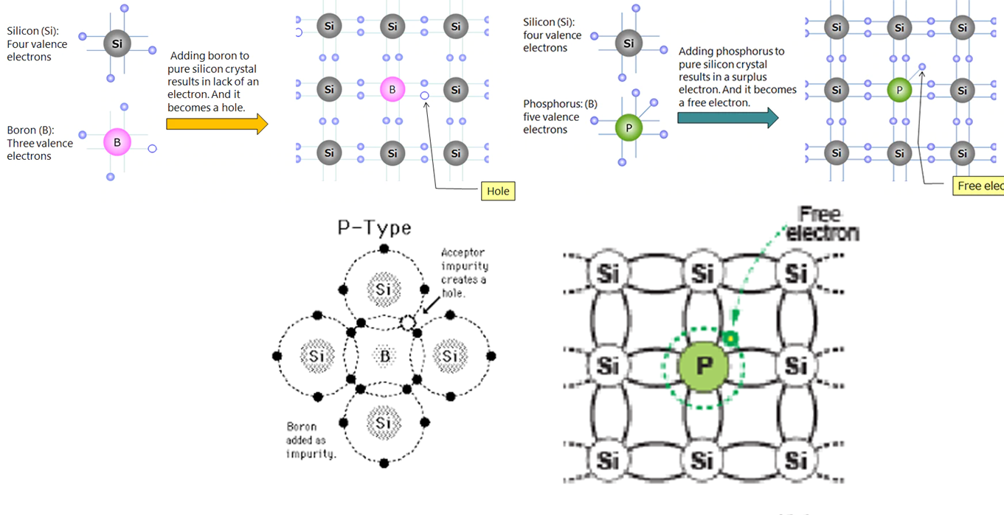
Μπαραδάκης Ε.
n-type
p-type

Slide 3
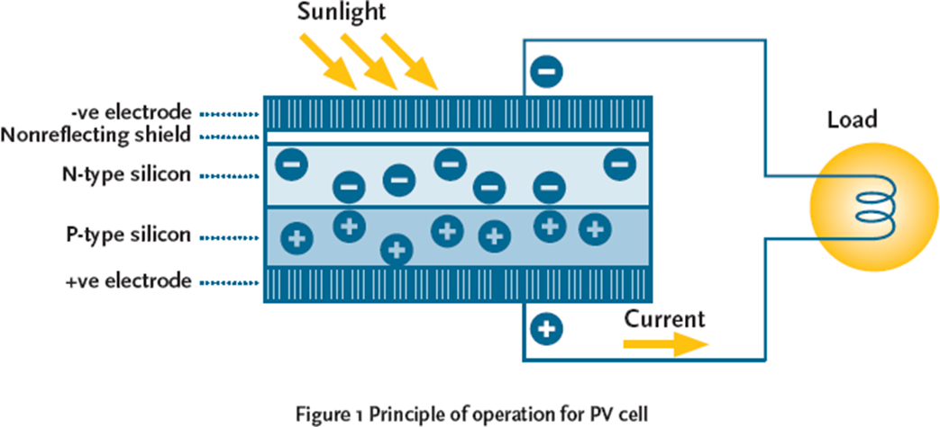
Μπαραδάκης Ε.
Photovoltaic Effect

Slide 4
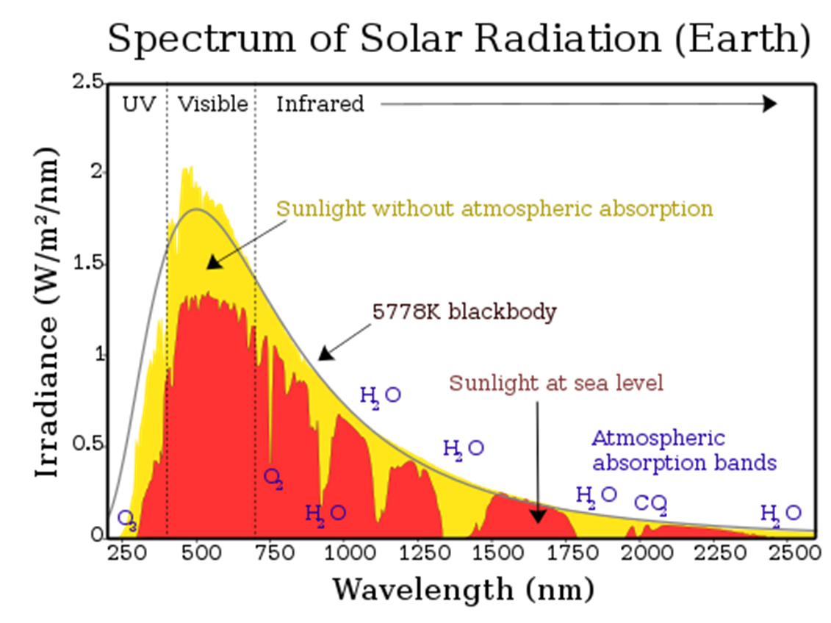
Μπαραδάκης Ε.

Slide 5
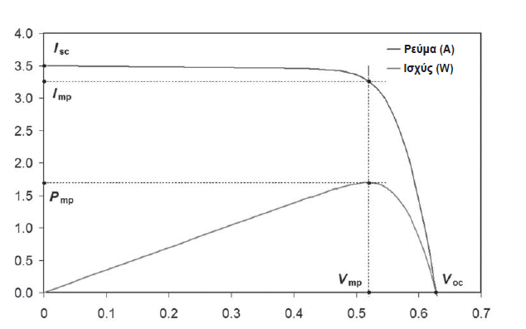
Μπαραδάκης Ε.
Characteristics of photovoltaic cell
Current I (A)
Voltage V (V)

Slide 6
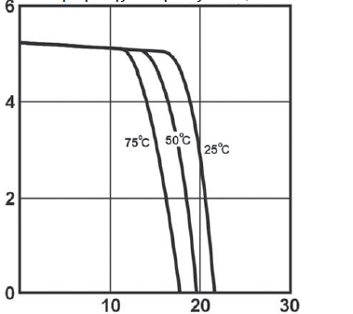
Μπαραδάκης Ε.
Temperature dependency of photovoltaic cell
Current I (A)
Voltage V (V)

Slide 7
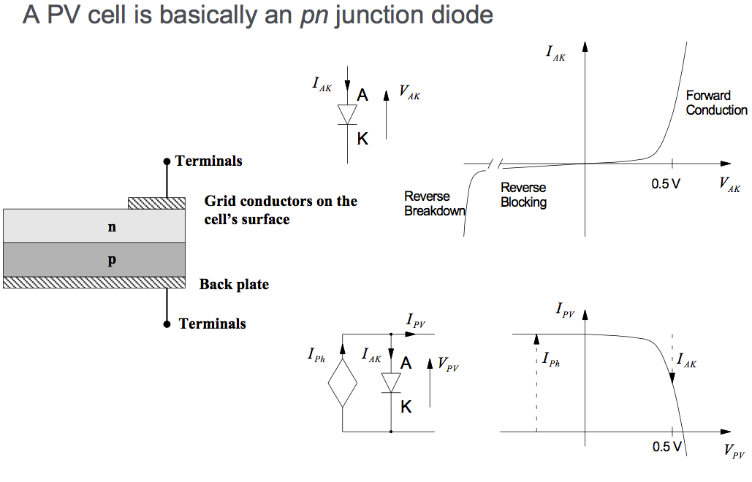
Μπαραδάκης Ε.

Slide 8
Μπαραδάκης Ε.
How much electric energy produces 1 m² pv system with pv efficiency n_{pv}= 0.12 in area with average daily solar irradiation 6 kWh/ m². Correction coefficient for temperature is 0.8 and for pollution 0.95.
The formula for energy produced by a pv system gives
E_{p} = n_{p} ⋅ n_{t} ⋅ n_{pv} ⋅ Esun ⋅ A = 0.95 ⋅ 0.8 ⋅ 0.12 ⋅ 6 kWh/ m² ⋅ 1 m² = 0.55 kWh/ m² per day

Slide 9
Μπαραδάκης Ε.
A PV system has nominal capacity 5 kW_{p} and efficiency 0.12. Find the area of the system. How much electric energy produces this system when average daily solar irradiation is 6 kWh/ m². Correction coefficient for temperature is 0.8 and for pollution 0.95.
Nominal capacity means
P_{n} = n_{pv} ⋅ 1000 W/m² ⋅ A ⇒ 5 kW = 0.12 ⋅ 1000 W/m² ⋅ A ⇒ A = 5000 W/120 m² = 41.67 m²
So daily energy production for this system is
E_{p} = n_{p} ⋅ n_{t} ⋅ n_{pv} ⋅ Esun ⋅ A = 0.95 ⋅ 0.8 ⋅ 0.12 ⋅ 6 kWh/ m² ⋅ 41.67 m² = 22.8 kWh per day

Slide 10
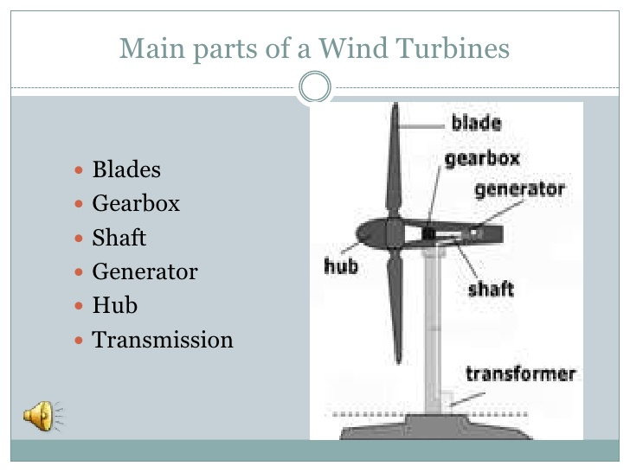
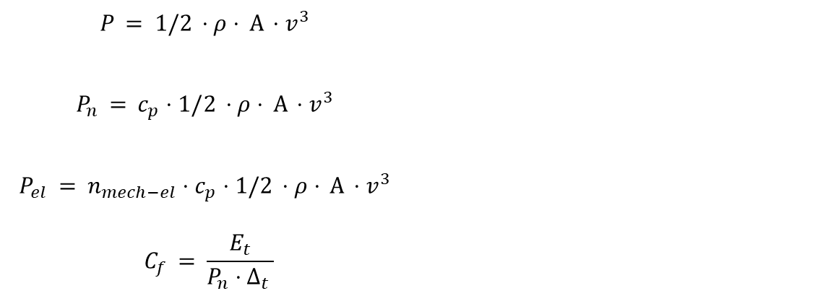
Μπαραδάκης Ε.
$$P = 1/2 ⋅ρ⋅ Α ⋅v^{3}$$ $$P_{n} = c_{p}⋅1/2 ⋅ρ⋅ Α ⋅v^{3}$$ $$P_{el} = {n_{mech−el}⋅c}_{p}⋅1/2 ⋅ρ⋅ Α ⋅v^{3}$$ $$C_{f} = \frac{E_{t}}{P_{n}⋅Δ_{t} }$$

Slide 11
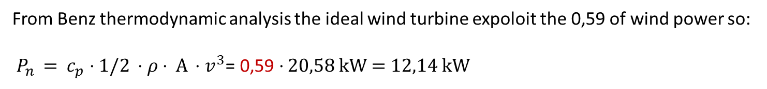
Μπαραδάκης Ε.
In a specific location average wind velocity is v = 7 m/s.
Calculate the power of wind in a area A = 100 m². Air density ρ = 1,2 kg/m³.
How much the power of ideal wind turbine;
Wind power: $P = 1/2 ⋅ρ⋅ Α ⋅v^{3}$= 0,5 $⋅$ 1,2 kg/m³ $⋅$ 100 m² $⋅$ 7³ m³/s³ = 20580 W = 20,58 kW
From Benz thermodynamic analysis the ideal wind turbine expoloit the 0,59 of wind power so:
$P_{n} = c_{p}⋅1/2 ⋅ρ⋅ Α ⋅v^{3}$= 0,59 $⋅$20,58 kW = 12,14 kW

Slide 12
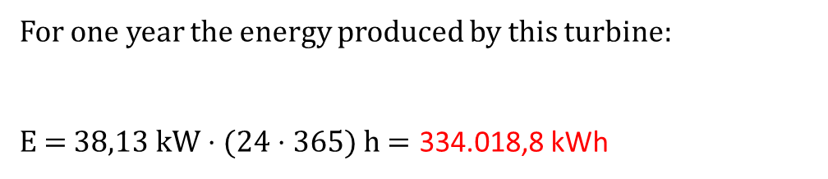
Μπαραδάκης Ε.
In a specific location average wind velocity is v = 7 m/s. Calculate the energy produces an ideal wind turbine with blade radius R = 10 m. Air density ρ = 1,2 kg/m³.
From Benz thermodynamic analysis the ideal wind turbine expoloit the 0,59 of wind power so:
$P_{n} = c_{p}⋅1/2 ⋅ρ⋅ Α ⋅v^{3}$= 0,59 $⋅$ $1/2 ⋅\text{1,2 }\text{kg}\text{/}\text{m}\text{3} ⋅ \text{3,14}⋅\text{10}\text{2} \text{m}\text{2 }⋅\text{ 7 }\text{m}\text{3}\text{/}\text{s}\text{3}$= 38.126,51 W = 38,13 kW
For one year the energy produced by this turbine:
E = 38,13 kW $⋅$ (24 $⋅$365) h $=\text{334.018,8}$ kWh

Slide 13
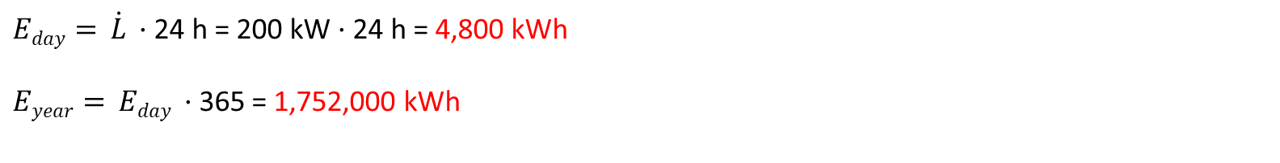
Μπαραδάκης Ε.
Building with area 2.000 m² and coefficient of thermal losses 10 W/m² ºC and desirable inside temperature Τ = 22 ºC and average ambiend temperature T₂ = 12 ºC. Calculate the the thermal power. Calculate the thermal energy per day and year.
For thermal power:
$\dot{L} = {\left(UA\right)}_{area} ·A· \left(T_{d} − T_{s}\right)$ = 10 W/m² ºC $·\text{2.000 }\text{m}\text{2}· \left(22 − 12\right)$ ºC = 200,000 W = 200 kW
Thermal energy:
$Eday= \dot{L} ·\text{24 }\text{h}$= 200 kW $·\text{24 }\text{h}$= 4,800 kWh
$Eyear= Eday ·\text{365 }$= 1,752,000‬ kWh

